Slide 1
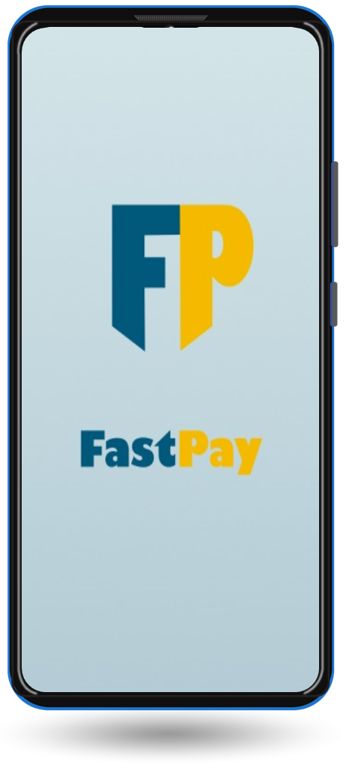
FastPay
Digital Wallet
Digital Transformation for social change

Slide 2
Team ZeroBug
Team members :
1. Aashna Saju
2. Agna Jain
3. Aleena Saira Laijoo
4. Ami Thomas
5. Amrutha M J
6. Anton Roy
7. Divya Elizabeth George

Slide 3
Outline
Problem Statement
Solution Proposal
Use Case Diagram
Prototype
Next Steps

Slide 4
Problem statement
People with limited experience with technology and poor financial literacy such as elderly people and people who live in the rural areas find it difficult to navigate and use digital wallets and payment gateways like Google Pay, PayTM, PhonePe, PayPal and bank apps like SBI YONO.

Slide 5
Solution description
A simple web based application can be developed that helps all users to easily manage their finances online by themselves.
The basic functions of the application that user sees are:
Send Money
Pay Bills
Transaction History
Check Balance
Simplified layout and users can select their local language for their ease and comfort.

Slide 6
Why it’s better than existing solutions
Unnecessary banners are avoided
Button sizes are at least 50 px
Font size are kept to minimum of 16 px
Icons are labeled with text
Regional language can be selected
Contrast Ratio is greater than 7
User flow is streamlined

Slide 7
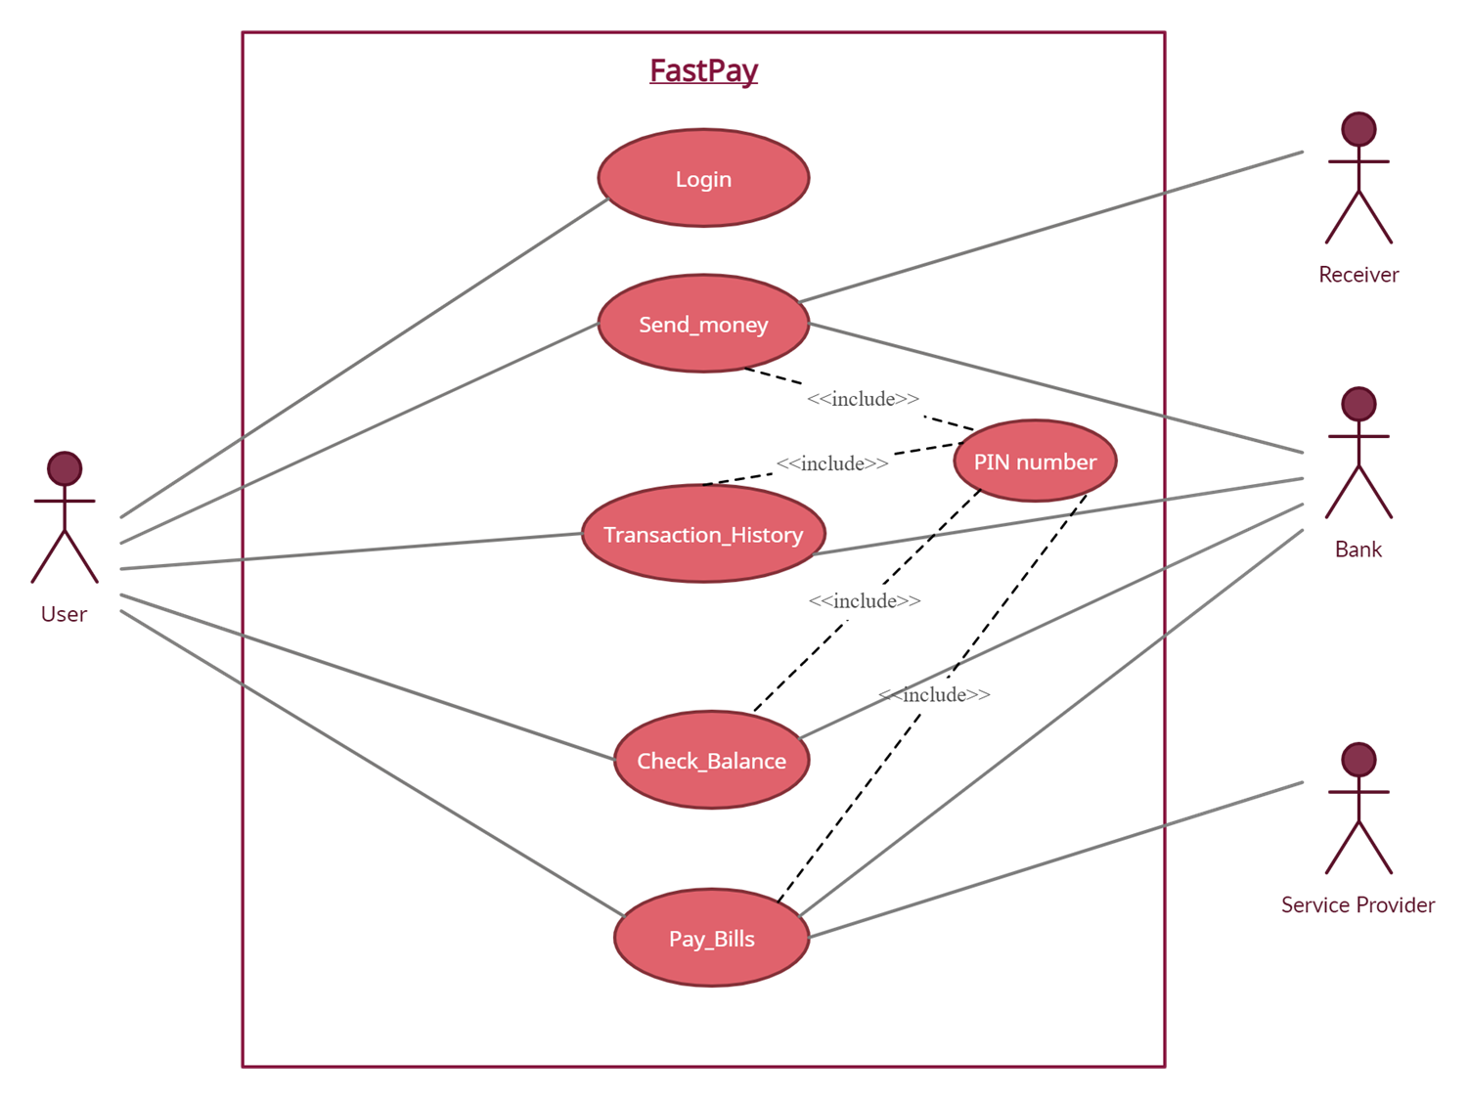
Use Case
Diagram

Slide 8
Prototype
https://www.figma.com/proto/oUonJDuuCI7u0v2ZwSWu6v/Untitled?page-id=0%3A1&node-id=69%3A525&viewport=241%2C48%2C0.18&scaling=scale-down&starting-point-node-id=3%3A2

Slide 9
What next?
Can be used in phones other than smartphones
Introducing Voice Assistant
Meeting with financial advisor
Apply loans

Slide 10
Conclusion
Technologically challenged people often struggle with digital payment platforms.
Design an application with simple user interface which helps in quick and easy access to significant options.
Elderly people and people belonging to rural areas can manage their finances on their own.

Slide 11
THANK YOU

